Slide 1
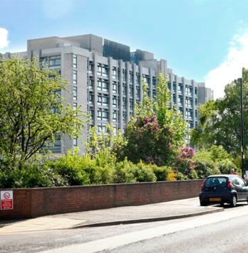
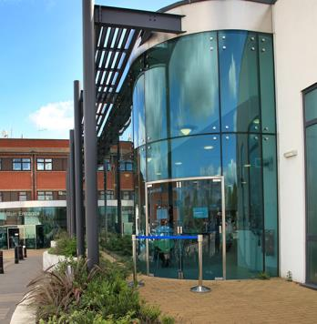
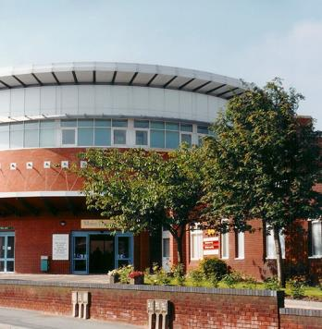
Clinical Admin Review
David Purdue, Deputy Chief Executive & Chief Operating Officer

Slide 2
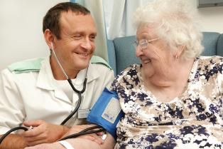
Introduction
The Clinical Admin review was started in August 2016
The vision of the project was to refresh our admin function so that it supports our new divisional structure, providing a patient-focused and top-notice service
We also wanted to make a positive difference to your working life – building on the things that work and improving those that don’t.
www.dbth.nhs.uk

Slide 3
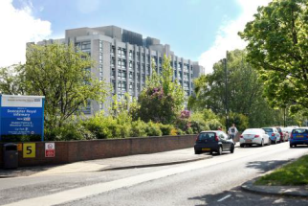
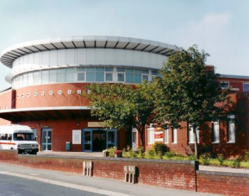
Where are we now?
We are pleased to announce that the Clinical Admin Review has now finished
We want to thank everyone for their patience during this time and can confirm the following:
There will be no redundancies
We will explore a range of options with staff in an effort to only utilise down-banding of staff currently in post as a last resort.
www.dbth.nhs.uk

Slide 4
Reasons for the review
To enhance consistency of our patient pathways between areas and departments
To provide a coherent structure for the role, with room for advancement and development
To improve operational performance, communication and data collection
To truly define the role of an admin at the Trust and ensure consistency amongst roles (over 60 job descriptions!)
To empower our admin staff to apply their skill and expertise to maximise any opportunities to improve efficiency and quality
www.dbth.nhs.uk

Slide 5
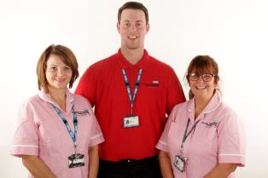
So what have we been doing?
This review has been one of the largest pieces of work undertaken by the Trust. In two years we have:
Evaluated and analyzed our current admin service
Validated this analysis against ESR data
Developed a ‘base-line’ and indicators
Undertaken a number of data collection exercise (some of you will have been involved in these)
Developed a toolkit to calculate our requirements based on patient activity
Compared potential models with what is in place Alderhay, Nottingham and North Lincolnshire and Goole
www.dbth.nhs.uk

Slide 6
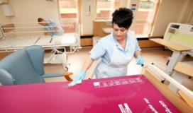
What then?
We have tested all of this information with our services to find out if it fits with our service models:
Worked with senior staff to design Clinical Admin structure
Created a methodology and vision
Shared this with all Care Groups (Divisions) for feedback which has then been collated
Developed a smaller number of standardised job descriptions to compliment the new model
Developed a refreshed Clinical Admin service and taken to senior managers for sign-off
Conducted a HR assessment and what this means for current staff
Planned what is needed for successful delivery and transition
www.dbth.nhs.uk

Slide 7
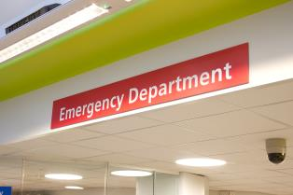
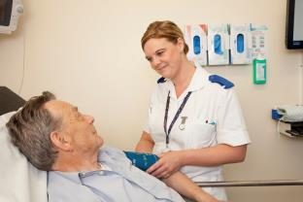
What will be different? (1/2)
As stated, it was always our goal to reduce the number of job descriptions, which we feel has been achieved
We have also looked at ensuring consistency across roles and what types of tasks are expected
This has resulted in 12 roles (down from a high of 60)
We have proposed changes to job titles but these are not final and we would welcome staffs views and opinions on job titles
www.dbth.nhs.uk

Slide 8
What will be different? (2/2)
As stated, we do not plan to make any members of staff redundant as part of this process and will only consider down-banding roles as a final option
We will implement a more substantive career pathway for development with room for apprenticeships
We will bring to an end fixed-term contracts and appoint to substantive positions
We will hopefully realize the ambitions as set out at the start of the review – improving the things that work and changing those that don’t.
www.dbth.nhs.uk

Slide 9
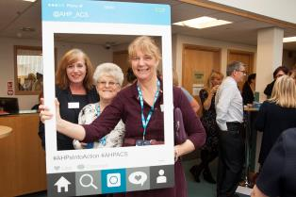
What comes next? (1/2)
As agreed with staff side representatives we plan to launch a formal consultation with all effected staff in the very near future
The consultation process will provide an opportunity for further discussions within your Divisions to allow staff to give feedback and comment
Divisional Management Team will then be asked to review their structures, communicate with staff and consider options to move towards the new structure and operating model
www.dbth.nhs.uk

Slide 10
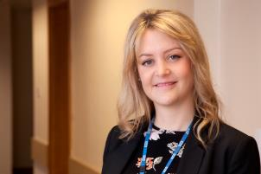
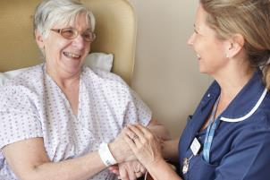
What comes next? (2/2)
Divisional Teams will then submit plans of how they intend to manage the changes and the timescales in which they propose to move to the new model
Plans will then be considered centrally and career development/job opportunities will be advertised internally
Throughout this process we intend to communicate and engaged with you and we thank you for your patience throughout this project.
www.dbth.nhs.uk

Slide 11
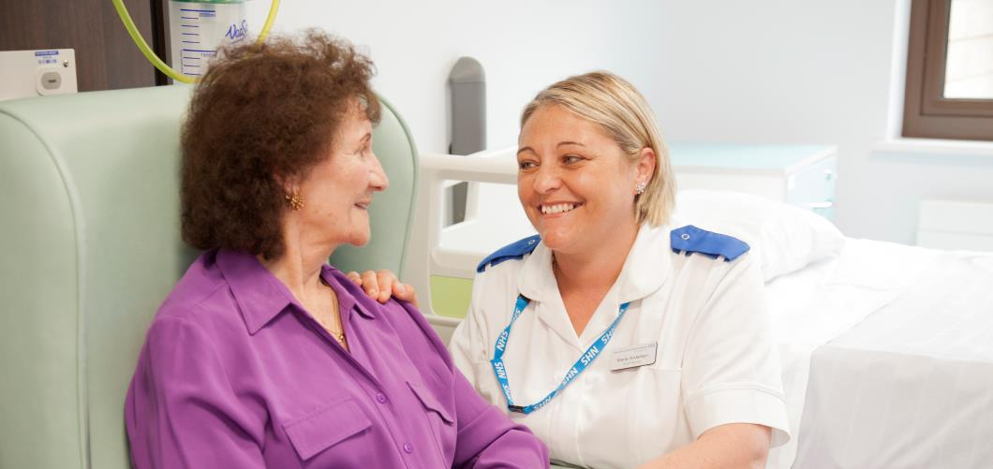
Thank you, any questions?

