Slide 1
Bassetlaw Place Based Partnership: Place Plan 2023/4
Introduction
The Health and Care Act 2022 facilitated significant opportunities for collaboration and partnership working at all levels within the health and care system. Place-Based Partnerships (PBP) are recognised as significant contributors to partnership working by bringing together key stakeholders in formal collaborative mechanisms. As such, PBPs are well placed to support Integrated Care Boards (ICBs) to deliver their core aims, priorities and objectives. By bringing local voices together, across health and care sectors as well as communities, they are ideally suited to designing and delivering transformational initiatives sensitised to the distinctive needs and characteristics of local populations at a sub-system level. How PBPs work within the system is represented in Diagram 1.
Diagram 1
Our Vision for our Bassetlaw community:
Bassetlaw Place Partners working together to enable everyone in Bassetlaw to live healthier and happier lives, to prosper in their communities and remain independent throughout life

Slide 2
Bassetlaw Place Based Partnership: Place Plan 2023/4
Bassetlaw PBP has a long history of collaborative working to address the population needs of its 120,000 citizens. The PBP has established a local vision and priorities for Bassetlaw that are aligned with the Nottinghamshire Health and Wellbeing Strategy. Since July 2022, the PBP has also sought to actively engage in the delivery of the strategic priorities of NHS Nottingham and Nottinghamshire ICB following its transition from the South Yorkshire and Bassetlaw ICS. The Bassetlaw PBP comprises Executive level representation from a wide range of local statutory and Voluntary Community and Social Enterprise (VCSE) organisations. These include:
Bassetlaw Community and Voluntary Service
Bassetlaw District Council
NHS Nottingham and Nottinghamshire ICB
Doncaster and Bassetlaw Teaching Hospitals NHS Foundation Trust
Healthwatch Nottingham and Nottinghamshire
Nottinghamshire County Council
Nottinghamshire Healthcare NHS Foundation Trust
Bassetlaw Primary Care Networks
Bassetlaw Improvement District
During 2022/23 Bassetlaw PBP agreed six priorities on which to focus our collective efforts in order to explore and deliver new ways of working to address our local challenges – finding better solutions where coming together ‘added value’ and achieved improved outcomes. These priorities have been reviewed in light of the publication of the Nottingham and Nottinghamshire ICB Integrated Care Plan. Our priorities for 2023/4 are provided below.
This 2023/4 Plan sets out our priorities for the coming year, what our intended outcomes are and how we hope to achieve them through collaborative working at a local level.

Slide 3
Key health and care challenges in Bassetlaw
The guiding purpose of the Bassetlaw PBP is to address issues of health inequalities in Bassetlaw. Key health and care challenges include:
Life expectancy for both men and women is lower than the England average- with even lower rates of 6.7 years for men and 5.8 years for women in the most deprived areas compared most affluent areas of Bassetlaw.
8.3% of the population live within the 10% most deprived areas across England and 21.5% live in the 20% most deprived areas.
36.6% of children live in low income out of work households compared with 30.6% across England
22% of people have no qualifications compared with 18% across England
41.2% of residents are economically inactive compared with 39.1% across England
17% of households have no car, and as a rural area with poor transport links accessing services is a challenge.
20% of people have a limiting long-term illness compared with 17% across England
Bassetlaw has higher rates of childhood obesity at 25.6% in comparison to the England average at 22.6%
Bassetlaw rates of adult obesity are higher at 67.4% in compassion to the England average at 63%
Bassetlaw has a significantly higher rates of suicide at 14.6% per 100,000 population in comparison England average 10.4%
26.2% of adults are smokers compared with the England average of 22.2%
13.1% of pregnant women smoke at time of delivery at in compassion to the England average 9.6%
36.3% adults with long term mental health conditions are smokers compared with the England average of 26.3%
Bassetlaw rates of emergency hospital admissions for COPD are higher at 429.7 per 10,000 in compassion to the England average of 415.1.
2021 Census figures evidence that the Bassetlaw’s population has increased by 4.4% between 2011-2021, with a 24.6% increase in people aged 65 years and over.
Bassetlaw’s approximate population aged 65-90+ is 22.33%, compared the England average of 19.43% and Nottingham and Nottinghamshire’s average of 17.85%.
Recorded dementia diagnosis rates are higher in Bassetlaw 71.8% compared with the England average of 62%

Slide 4
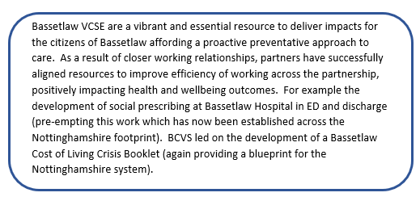
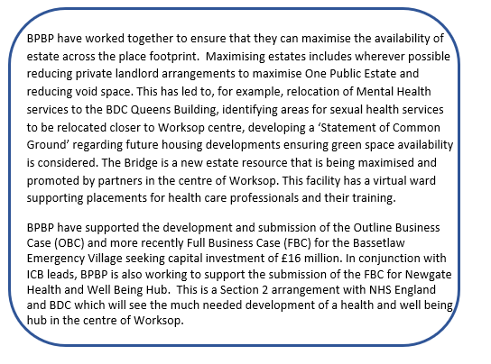
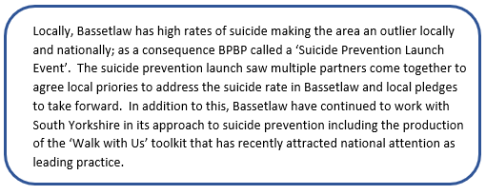
Case Studies: Examples of what we have achieved by working together in 2022/3
Cost of Living Response
Creating efficiencies and promoting value for money: Estates
Addressing our population health challenges: Suicide Prevention Alliance

Slide 5
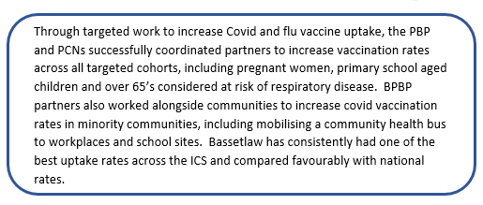
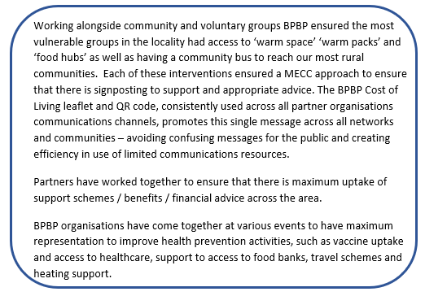
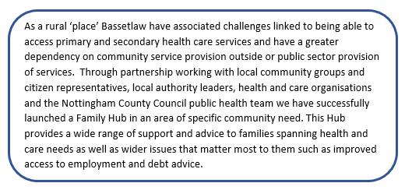
Case Studies: Examples of what we have achieved by working together in 2022/3
Promoting ill health prevention: Vaccination
Collaborating to support our most vulnerable
Supporting local families in most need

Slide 6
Bassetlaw Place Pan & Priorities for 2023/24
What we are trying to achieve
Starting Well (0-25 Years)
Reducing asthma symptoms including asthma attacks and address over reliance on reliever medication
Stabilising the increase in childhood obesity rates
Promote ill health prevention
Prioritising those children in greatest need
Increase access to mental health support
What we will be proud of
Our community feeling supported to live healthier lives and prevent ill health
Our population feeling connected within their community
People feeling they were supported to remain independent and look after their own health and wellbeing
Living Well
Improve access for people experiencing severe mental illness, multiple disadvantage, financial vulnerabilities, homelessness, multiple or life limiting illness, people with learning disabilities and/or autism and those from ethnic minority backgrounds and/or living in less engaged geographical areas care leavers
Promote ill health prevention (incl. earlier cancer diagnosis)
Reduce smoking prevalence
Increase access to mental health support
Bassetlaw Place Based Priorities
Reducing Health Inequalities
Ageing Well
Reduce social isolation and loneliness
Reduce emergency hospital admissions
Increase digital confidence and competence
Increase support for those with severe to moderate frailty
Working Well Together
Collaboratively improve health and wellbeing outcomes for local citizens
Avoid duplication and maximise local resources
Develop integrated working at a Neighbourhood and Place level

Slide 7
Bassetlaw Place Delivery Plan 2023/4
Stabilise the rising rates of obese and overweight children in year six
PBP Delivery Team Key Initiatives
10% increase in CYP engaged with MMIM campaign with 30% of all CYP engaged demonstrating increased physical activity levels
Bassetlaw Obesity Group re-established and Action Plan produced for in-year initiatives
Move More in May (MMIM) campaign to increase physical activity
Food and nutrition advice support campaign using existing initiatives at Place e.g. Food Hubs, The School of Artisan Food Best Food Forward Project providing evidence-based advice within local secondary schools.
Plot 50- Allotment Project within deprived area providing advice on ‘grow your own’ and recipe advice working with the Food Insecurity Network
Development of Integrated Neighbourhood Teams (INT)and review of Place pathway for respiratory related ill health in C&YP
Awareness and information campaign for effective management of asthma medication and attack prevention (including Schools, parents, carers, communities, employers etc.)
Extend the Family Hub experience for communities of significant disadvantage working as part of the BDC Social Prosperity Fund initiatives
Bassetlaw Children and Young Peoples Mental Health Alliance Action Plan produced for in-year initiatives
INT development & HIIF outcomes
10% reduction in emergency admissions related to asthma
START WELL (0-25 YEARS)
KEY SUCCESS MEASURES
10% increase in CYP annual asthma reviews completed
80% children and young people accessing VCSE commissioned support demonstrate improved health and wellbeing
Maintain or increase numbers of LGBT+ CYP accessing support and mental health intervention
Core 20+ 5
H&WB Strategy
ICP Strategy
BDC Strategic plan
Supported by contributing work from across Bassetlaw Partner organisations outside the formal Partnership arrangements.

Slide 8
Bassetlaw Place Plan 2023/4
Monitoring standards implemented across PBP
10% increase in community health & wellbeing events (baseline 2019-20)
PBP Delivery Team Key Initiatives
10% increase in cancer screening uptake (baseline 2019-20)
Develop monitoring standards across partnerships, supporting to identify target population and improve outcomes
Ethnic Minority Group focused initiatives e.g. Eastern European and Hong Kong nationals community events
Awareness and information campaigns focused on cancer and screening
Development of Integrated Neighbourhood Teams and Strengths based asset mapping of current LTC pathways
Cost of living partner initiatives e.g. Food Hubs and warm spaces
Development of functional role of Community Ward Coordinator using existing PCN resources
Bassetlaw Adult Mental Health Alliance & Suicide Prevention Action Plan produced for in-year initiatives
Stop Smoking Programme initiatives and campaigns
PCN based Health Improvement Team supporting MH needs assessment and interventions
INT development & HIIF outcomes
10% increase in uptake of local food Hubs and Warm Spaces (baseline 2021/22)
10% increase in referrals into stop smoking services
LIVING WELL
KEY SUCCESS MEASURES
80% of adults accessing VCSE commissioned support demonstrate improved health and wellbeing
15% increase in referrals into ABL weight management -10% increase from Primary Care
Minimum of 80% completion of annual health checks for people with SMI and LD
Core 20+ 5
H&WB Strategy
ICP Strategy
BDC Strategic plan
Supported by contributing work from across Bassetlaw Partner organisations outside the formal Partnership arrangements.

Slide 9
Bassetlaw Place Plan 2023/4
Minimum 70% of 65yrs+ surveyed reporting reduction in social isolation and loneliness across PCN footprints
PBP Delivery Team Key Initiatives
INT development & HIIF outcomes
Baseline survey of social isolation and loneliness across Bassetlaw
Development of Integrated Neighbourhood Teams and review of Place pathway for frailty and associated same day care pathway
Development of Clinical Frailty Scale Assessment across all sectors
Clinical champion for each PCN to take the Frailty agenda forward
Development of Proactive Care pilot (Larwood & Bawtry PCN)
5% reduction in reduction in emergency admissions 65yrs+ (baseline 2019/20)
5% Reduction in emergency admissions as a result of falls between 2019/20 baseline
Clinical champion identified within each PCN
AGEING WELL
KEY SUCCESS MEASURES
5% increase in 65yrs+ engaging in NHS health check
10% increase in cancer screening uptake (baseline 2019-20)
Proactive Care pilot metrics in development
Core 20+ 5
H&WB Strategy
ICP Strategy
BDC Strategic plan
Supported by contributing work from across Bassetlaw Partner organisations outside the formal Partnership arrangements.

Slide 10
Bassetlaw Place Delivery Plan 2023/4
Local citizens report feeing listened to and that the Place Partnership is acting on what matters to most to people
PBP Delivery Team Key Initiatives
Partners identify where BPBP has ‘added value’ to delivery of Place level improvement in health and wellbeing outcomes for local people
Establish Bassetlaw ‘Citizen’s Panel’ to work closer with people who have lived experience and ensure co production and delivery of local initiatives and services
Development of a collaborative risk monitoring and performance dashboard associated with the delivery of the Place Plan
Developing shared arrangements across a number of partners for functions and/or Place Plan deliverables e.g. communications and engagement, data analytics, QI expertise, staff induction, staff training
Developing mechanisms for sharing resources and promoting integrated working arrangements across Place Partners
Developing and supporting our VCSE within Bassetlaw
Developing our social value awareness and evaluation
Increase in partners self reported level of engagement in the PBP and rating of collaboration
Established governance arrangements with clarity of functions across the partners
WORKING WELL TOGTHER
KEY SUCCESS MEASURES
There is a clear brand identity for the Place Partnership across the stakeholder community
Routine performance oversight of agreed Place Plan deliverables
Clarity of leadership of programmes of work
Core 20+ 5
H&WB Strategy
ICP Strategy
BDC Strategic plan
Supported by contributing work from across Bassetlaw Partner organisations outside the formal Partnership arrangements.

Slide 11
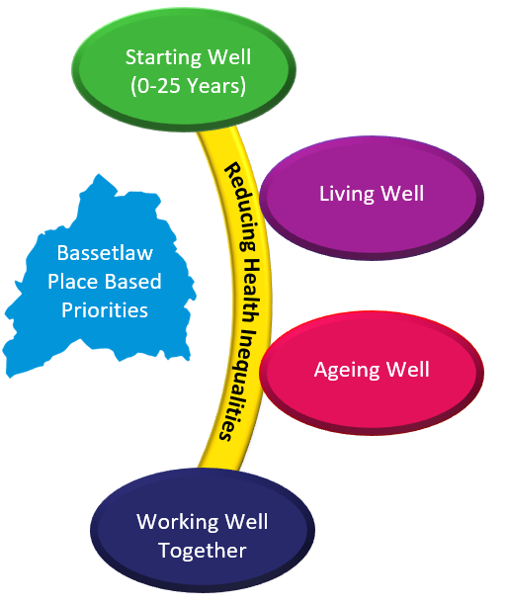
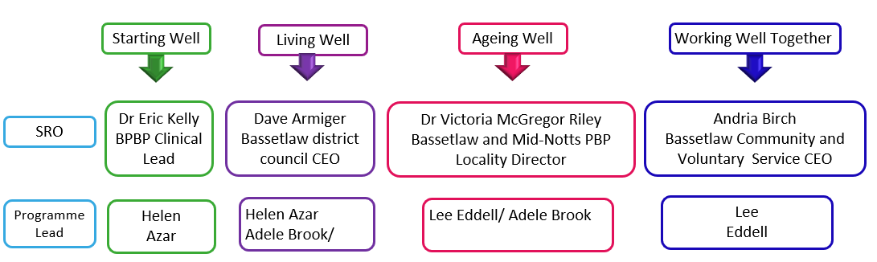
Bassetlaw Delivery Team
Bassetlaw Place Based Partnership
Bassetlaw Executive Cabinet
Programme Director

